Slide 1
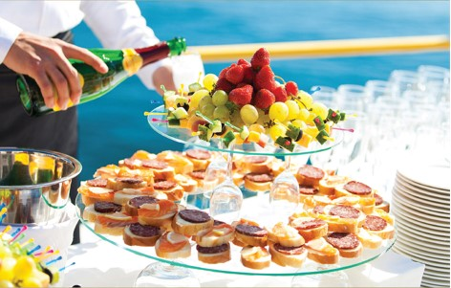


Chapter 9
The impact of technology on
customer service
Introduction to customer service
© Hudson & Hudson. Customer Service for Hospitality & Tourism 3rd edn

Slide 2
Topics Covered
Technological developments and communication
Technology and the consumer decision journey
Online tourism marketing
Service and the consumer decision journey
Advantages and disadvantages of electronic distribution of services

Slide 3
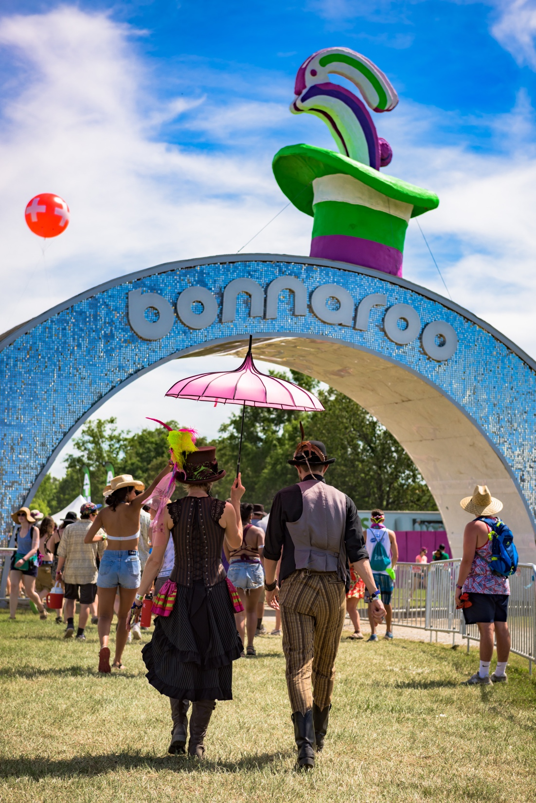
‘At Your Service’ Spotlight:
Leveraging social media at Bonnaroo Music Festival
One of the secrets to the success of music festivals is expert and, increasingly, innovative use of social media marketing aimed at promoting the festivals and encouraging customer loyalty.
The Bonnaroo Music & Arts Festival relies heavily on aggressive digital marketing campaigns both to generate publicity and attract visitors. Tactics include establishing relationships with bloggers to stimulate excitement for the concerts, leveraging social media sites such as Facebook and Twitter to achieve maximum exposure
They also use radio frequency identification (RFID) technology to foster engagement via a wristband.

Slide 4
The impact of technological developments on communication
Rapidly changing communications environment
  Dominated by digital technology
  Social networks supplanting brand networks
Consumers increasingly in control
  More access to information
  More ‘promiscuous’ in brand relationships
  How and when advertising is received
Post-purchase consumers behavior
  Customer review
Tourism marketers
  Internet growth in populous, developing nations
  Annual online sales increasing
  Touch points have changed
Digital technologies and automation will play a critical role in the future of travel post COVID-19.

Slide 5
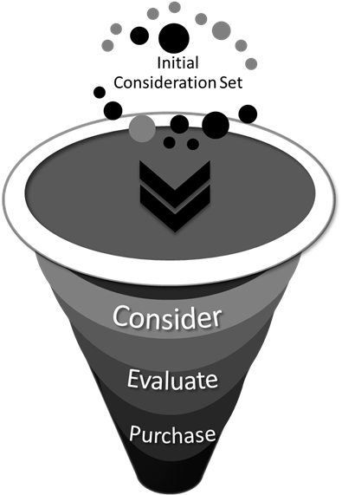
The traditional purchase funnel
Table 9.1

Slide 6
The consumer decision journey today
Figure 9.2 (Source: Adapted from Court et al. 2009)

Slide 7

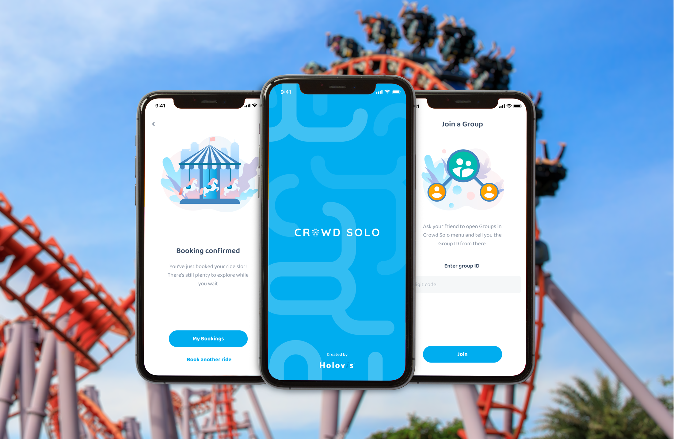
The consumer decision journey
‘Zero Moment of Truth’ (ZMOT)
Consideration stage
  Social media campaigns to drive traffic to websites
Evaluation stage
  Product-comparison sites increasing influential
  Digital ambassadors
  Incentives e.g. free vacations
  Virtual tours and virtual worlds
Buy stage
  Point of purchase
  Enjoy, advocate, and bond
  After purchase brand connection
  Crowd sourcing and brand innovation
  Consumer complaints

Slide 8
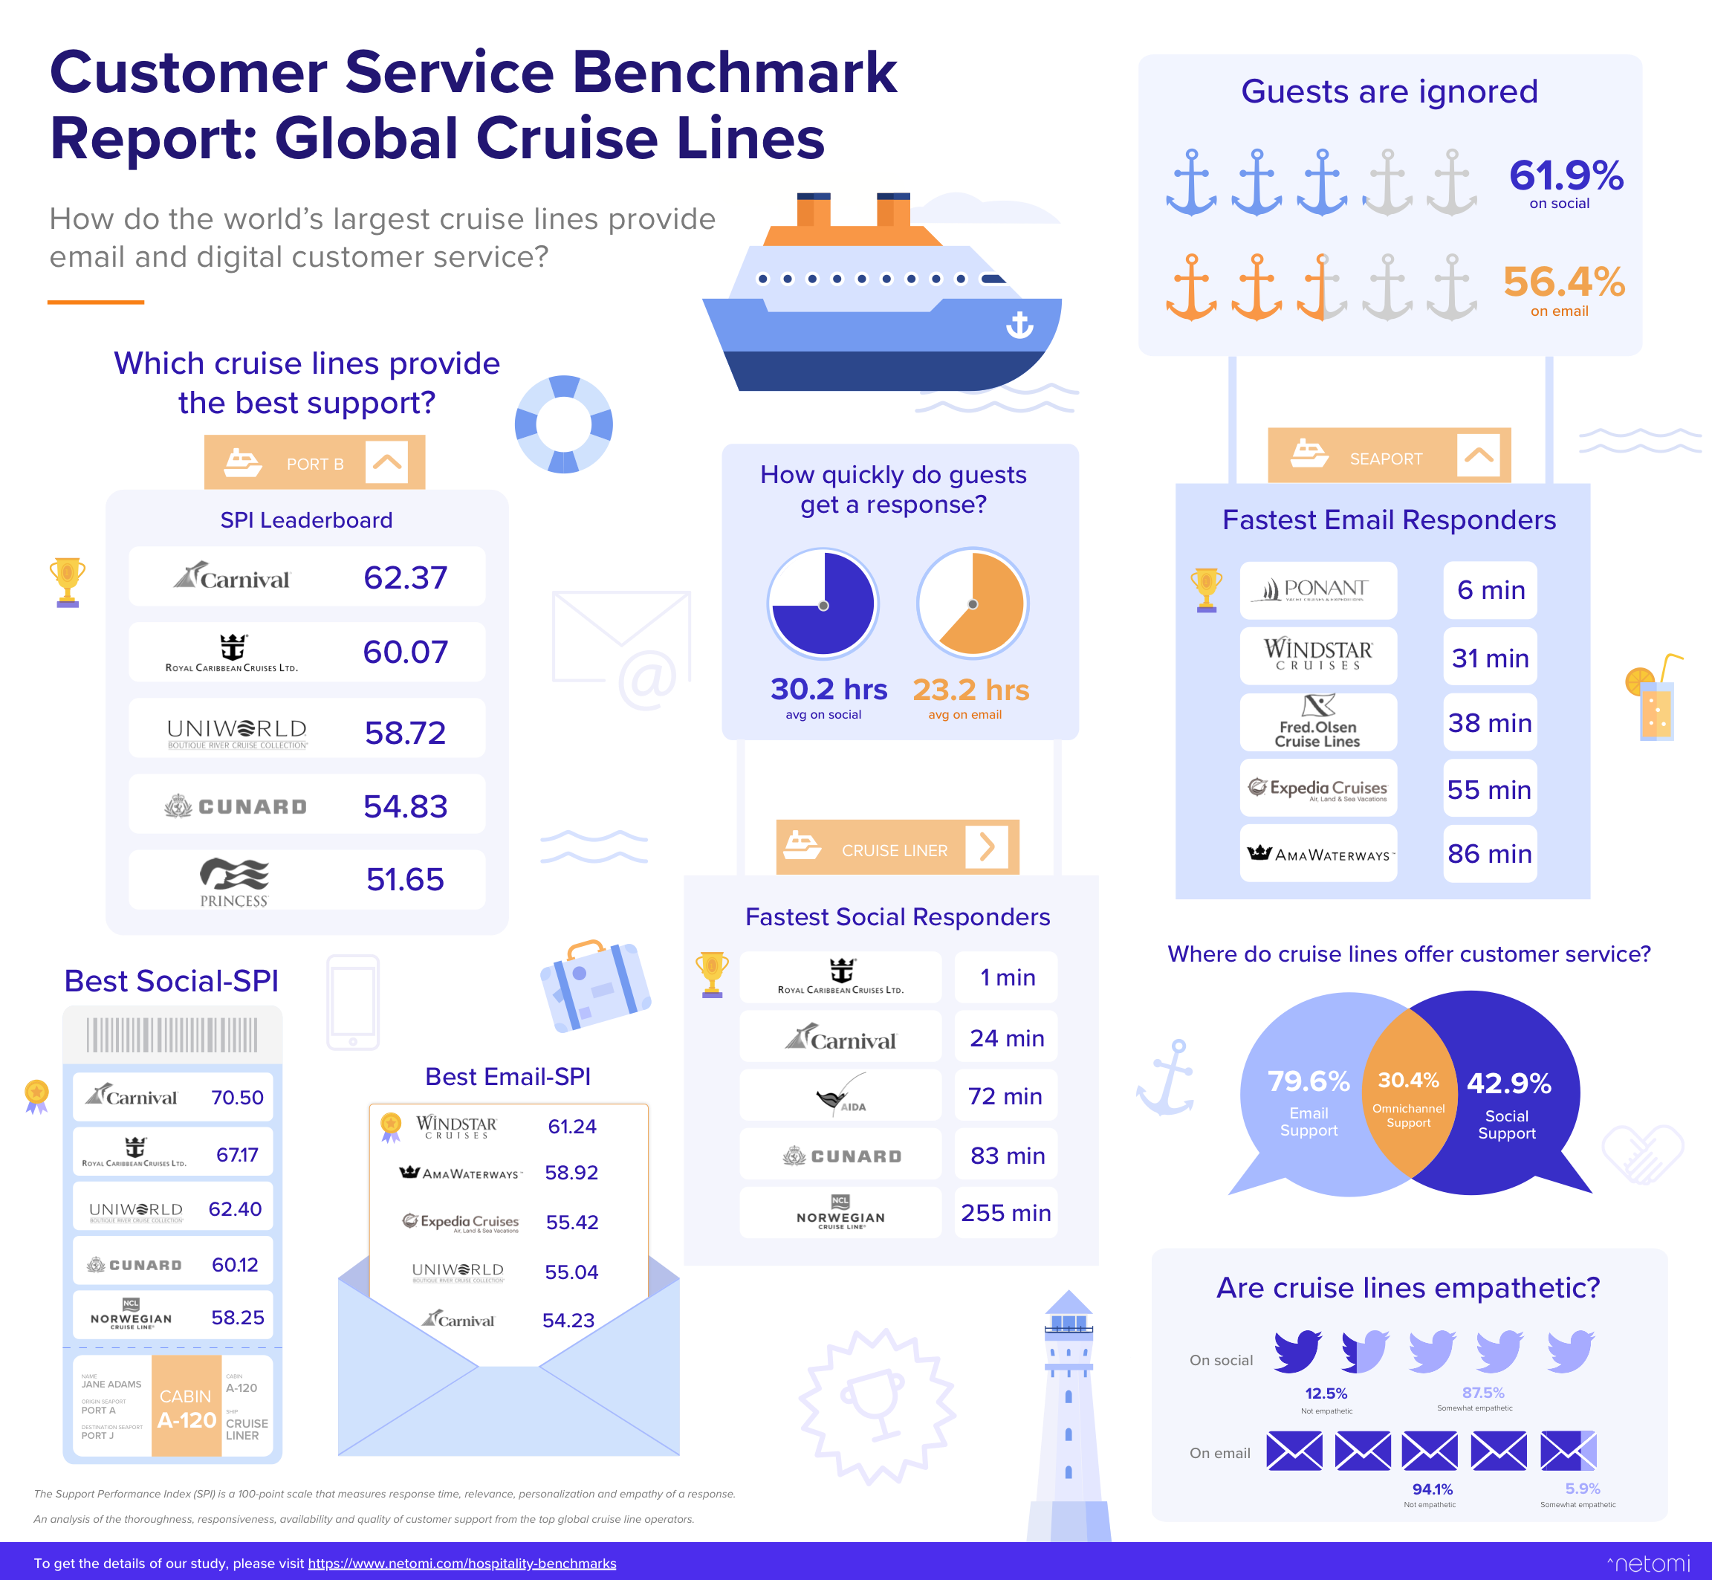

Slide 9
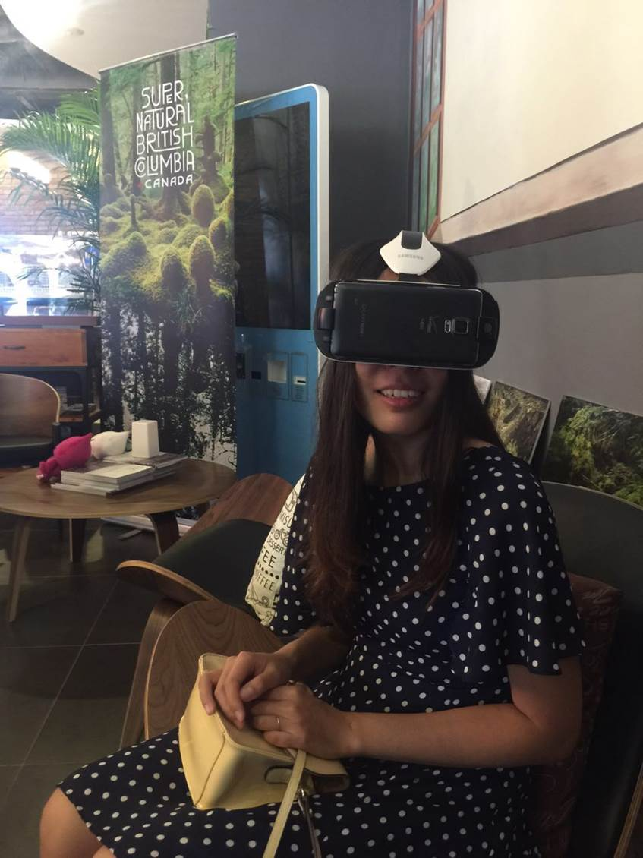
Service Snapshot:
Employing virtual reality to enhance the customer experience
One relatively new method of enhancing the customer experience is virtual reality
Destination marketing using virtual reality is gathering momentum (eg. British Columbia in Canada)
Marriott Hotels have also been testing virtual reality with their ‘teleporter’
In the airline sector, Virgin Atlantic launched an immersive digital experience with Microsoft in 2016
In the theme park sector, Six Flags and Samsung launched virtual reality roller coasters at nine theme parks across the U.S in 2017
During the COVID-19 pandemic, a number of destinations employed virtual reality to engage with consumers remotely while they could not travel.

Slide 10
e-Servicescape, website trust and purchase intentions
Figure 9.3 (Source: Adapted from Harris and Goode, 2010)

Slide 11
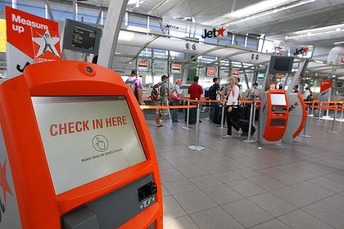
Delivering service through electronic channels and robots
Self-serve facilities will continue to evolve and play a more important role in service delivery
There are both advantages and disadvantages to this

Slide 12
Advantages and disadvantages of electronic distribution of services
Table 9.1 (Source: Adapted from Harris and Goode, 2010)

Slide 13
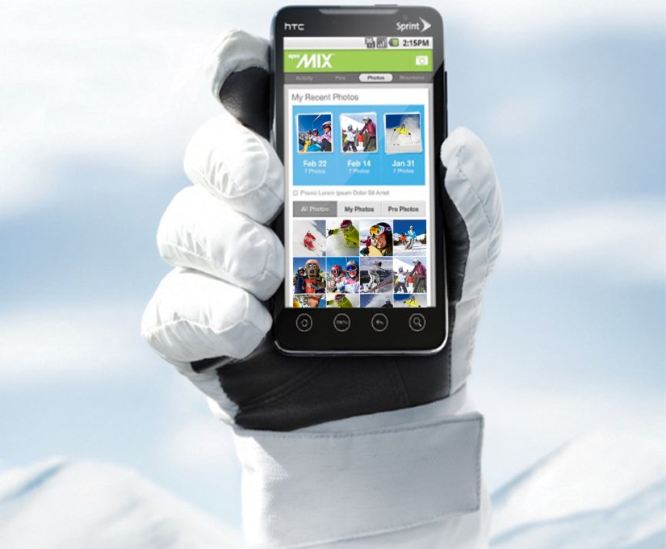
Case Study:
Vail Resorts using apps to capture memories on the mountain
Capturing memories on mountain and being able to share with friends and family is particularly important on a ski vacation.
Smart card technology
  Ski lift pass doubles as resort credit cards
  Multiple ski hills, resorts
EpicMix ski app
  Log runs, lifts taken
  Vertical mileage
  Pins for achievements
EpicMix account
  Personal and professional photos
  Trail map
  GPS hook up with friends and family
Social media
  Encourages story sharing

